Slide 1


A.V.C College of Engineering Department of Computer science & Engineering
Title : Gesture translation using computer vision
Supervisor: Dr. M.Devi sri nandhini
TEAM MEMBERS
BATCH NO: CSE 01
Arularasi.S | 820320104003
Santhoshini.B | 820320104032
Sowndharya.R | 820320104039
Sheela.V.G | 820320104312

Slide 2










TABLE OF CONTENTS
ABSTRACT
MODULES
INTRODUCTION
RESULTS
LITERATURE SURVEY
CONCLUSION
PROBLEM STATEMENT
FUTURE WORK
PROPOSED SYSTEM
ARCHITECTURE
DIAGRAM
PUBLICATION
2

Slide 3
ABSTRACT
Sign language detection faced issues like limited accuracy and difficulty in capturing subtle hand movements.
In this project, CNN-based detection, address these challenges by effectively capturing spatial patterns and hierarchical features in sign language gestures.
With CNNs, hand gestures are classified into corresponding sign language symbols, enhancing communication accessibility for the hearing impaired.
Utilizes convolutional neural networks (CNNs), a computer vision technique, to process sequential frames of sign language videos.
These algorithm tend to analyze “the movement of the hands and their features to enable efficient communication”

Slide 4
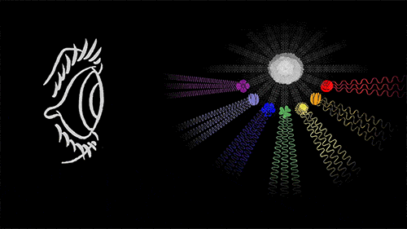
INTRODUCTION-COMPUTER VISION
Computer vision is a field of artificial intelligence that focuses on interpreting and understanding visual information such as images or videos.
The primary goal of computer vision is to replicate human vision capabilities using machines, allowing computers to analyze and understand the content of visual data in a manner similar to humans.
This includes tasks such as:
Image Recognition
Object Detection
Image Segmentation
Pose Estimation etc…

Slide 5
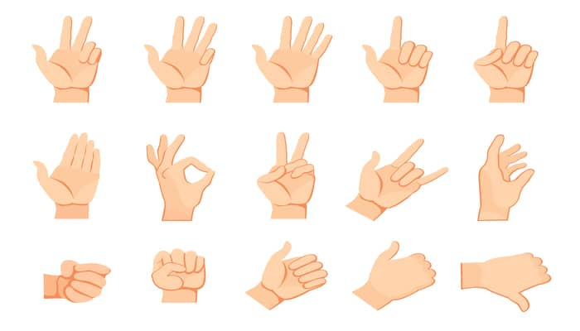
SIGN LANGUAGE SYMBOLS
Sign language symbols are hand gestures or movements representing words, phrases, or concepts used in communication by individuals with hearing impairments.
These symbols convey meaning through hand shape, orientation, movement, and facial expressions, forming a visual language.
By using sign language symbols, individuals can express themselves and communicate effectively without relying on spoken language.

Slide 6
LITERATURE SURVEY
S. No | Title | Authors | Name of the journal | Year | Methodology | Critics
1. | Gesture-to-Text Translation Using SURF for Indian Sign Language | Kaustubh Mani Tripathi Pooja Kamat Shruti Patil | Applied system innovation | 2023 | CNN and speeded-up robust features (SURF) | Achieved higher accuracy but, takes more computation time.
2. | Using Deep Learning in Sign Language Translation to Text | Carl Jose M.Guingab Ron Andrew Relayo Mark Joseph C | IEOM Society International | 2022 | Deep Learning-(Most studies is CNN, with 70%) | Far from being usable in actual scenario.

Slide 7
LITERATURE SURVEY
S. no | Title | Authors | Name of the journal | Year | Methodology | Critics
3. | Deep Learning for SLR: Current Techniques, Benchmarks, and Open Issues | Muhammmad Al-Qurishi Thariq Khalid Riad Souissi | IEEE Access | 2021 | Deep Learning-(The period covered is between 2014-2021) | Most algorithms tend to misinterpret an interrupted sign.
4. | Hand Gesture Recognition Based on Computer Vision: A Review of Techniques | Munir Oudah Ali Al-Naji Javaan Chahl | Journal of Imaging | 2020 | Computer Vision- (Glove-based attached sensor either connected to the computer or portable) | Distance limit & multi object problems. Dataset gesture match against input gesture & missing gestures.

Slide 8
LITERATURE SURVEY
S.no | Title | Authors | Name of the journal | Year | Methodology | Critics
5. | Machine translation from text to sign language: a systematic review | Navroz Kaur Kahlon Williamjeet Singh | Universal access in the information society | 2021 | Machine Translation -(During 1990s, the need for translating the spoken lang into a sl started sur-facing) | Accuracy issues. Several gaps in SLT and Generation from complete analysis.
6. | Sign language convertion to text and speech | Sai Deepthi BP Shiram Triwari | JETIR | 2022 | YOLO-(This is a s/w-based project which uses MediaPipe framework to detect hand gestures) | No real time input.

Slide 9
LITERATURE SURVEY
S.no | Title | Authors | Name of the journal | Year | Methodology | Critics
7. | Sign Language Recognition | Sathik Ram Kodandaram N.Pavan Kumar | TURCOMAT | 2021 | Deep Learning-(The creation of CNN classifier that can classify the hand gestures into English alphabets and digits) | Dataset only contains 0-9 & A-Z.
8. | Real-time Conversion of Sign Language to Text and Speech, and vice-versa | Supriya Agre Sohan Wasker Aman Vashishtha | JETIR | 2023 | Computer Vision-(The process involves a seamless flow of operations to ensure efficient real-time comn) | Gesture complexibility & dialect variations exist.

Slide 10
LITERATURE SURVEY
S. no | Title | Authors | Name of the journal | Year | Methodology | Critics
9. | Conversion of Sign Language To Text & Speech Using M/C Learning Techniques | Victoria Adebimpe Akano Adejoke O Olamiti | Journal of research & review in science | 2018 | Machine Learning-(the framework of FAST & SURF alg’s. The sys goes through various phases) | It captures the human image in the bg makes it harder to identify the sl Only 49 signs got used.
10. | A novel method for recognizing hand gestured sl using SGD alg.& CNN | Dr.Vinod B.Durai Mr.Anish Kiran Mr.Arind Rao | IJISAE | 2023 | Stochastic Gradient Descent Alg & CNN Techniques. (Converting char to ASCII to Binary.) | Takes time to process output. More number of datasets can be added.

Slide 11
PROBLEM IDENTIFICATION
Identifying challenges in sign language detection is crucial for improving communication accessibility for individuals with hearing impairments.
One primary issue lies in accurately capturing and interpreting the intricate hand movements and gestures that form the basis of sign language.
Variability in hand shapes, orientations, and movements, compounded by differences in signing styles among individuals, poses a significant challenge for automated detection systems.

Slide 12
PROPOSED SYSTEM
We used “handgesture.csv” dataset for gesture recognition using CNN for more accuracy.
The proposed method leverages CNNs, a deep learning architecture adept at learning spatial hierarchies of features, making them well-suited for detecting complex hand gestures inherent in sign language.
During training, the network learns to classify hand gestures into corresponding sign language symbols by minimizing a predefined loss function through back propagation.
Fine-tuning and optimization techniques ensure the model's robustness and generalization ability to accurately detect sign language gestures in real-world scenarios.

Slide 13

ARCHITECTURE DIAGRAM
Preprocessing
Capture
Segmentation
Preprocessing
TRAINING
Feature extraction
TESTING
Segmentation
Classification(CNN)
Using different layers
Feature Extraction
Classified file
Dataset
Recognized sign language
Detection
Recognized
gesture
Text
Speech

Slide 14

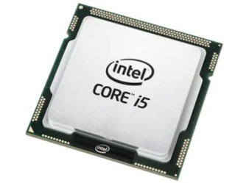
HARDWARE REQUIREMENTS
HARDWARE REQUIREMENTS:
Processors : Intel Core i5 processor 4300M at 2.60 GHz
Disk space : 320 GB
Operating systems : Windows10, macOS, and Linux

Slide 15
SOFTWARE REQUIREMENTS
SOFTWARE REQUIREMENTS
ServerSide: Python3.7.4(64-bit) or (32-bit)
ClientSide: HTML,CSS,Bootstrap
Libraries required: The following libraries are needed
•keras
•scikitlearn
•numpy
•tensorflow
•flask
•pyaudio

Slide 16
MODULES
DATA AQUISITION
Train/test dataset
Pre-processing
Classification
ACTION DETECTION

Slide 17

1.DATA ACQUISITION
This module serves as the entry point for the system, where hand gestures or movements captured through cameras or sensors are inputted.
It involves acquiring real-time or pre-recorded video sequences of sign language gestures performed by individuals.
The input hand module prepares the raw video data for further processing and analysis by subsequent modules.

Slide 18
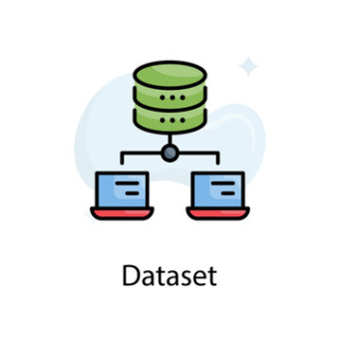
2.TRAIN/TEST DATASET
In this module, a comprehensive dataset of sign language gestures is collected and divided into training and testing subsets.
The training dataset is used to train the model, such as a Convolutional Neural Network (CNN), to recognize and classify sign language gestures.
The testing dataset is used to evaluate the performance of the trained model and assess its accuracy and generalization capabilities.

Slide 19
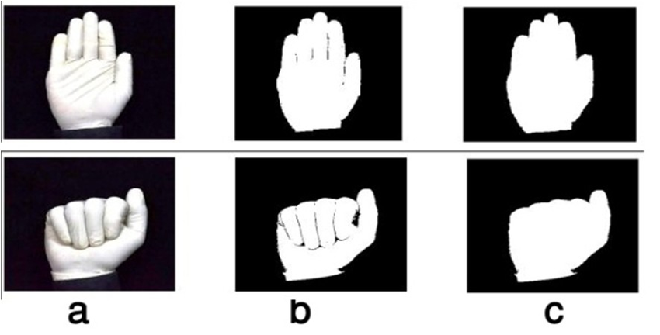
3.PRE-PROCESSING
Pre-processing is a crucial step that prepares the input data for feature extraction and classification.
It involves various operations such as resizing, normalization, and noise reduction to enhance the quality and consistency of the input hand images or video frames.
Pre-processing techniques ensure that the input data is standardized and suitable for analysis by the deep learning model.

Slide 20
RESIZING
Resizing images to a specific width (W) and height (H):
New_width = W
New_height = H
OpenCV library is used to perform resizing, which internally handle the interpolation and scaling of pixel values.
64*64 pixels is being used as the resized image here.
CODE:
import cv2
def resize_image(image, width, height):
if isinstance(image, str):
image = cv2.imread(image)
resized_image = cv2.resize(image, (width, height))
return resized_image

Slide 21
RESIZING
Resizing involves changing the dimensions of an image to a predefined size while preserving its aspect ratio. Common resizing techniques include interpolation methods like bilinear or bicubic interpolation.
To resize the 3x3 images to a size of 2x2.
Bilinear interpolation is commonly used to resize images. It calculates new pixel values by averaging the four nearest pixels in the original image.
RESULT:
[100, 200] --> [ (100 + 150 + 50 + 75) / 4, (200 + 125 + 25 + 175) / 4 ]
[ 25, 225] --> [ (25 + 175 + 200 + 50) / 4, (225 + 125 + 150 + 100) / 4 ]

Slide 22
NORMALIZATION
Normalization is a preprocessing technique used to scale numeric data to a specific range. In the context of image processing and computer vision, normalization typically refers to scaling pixel values within an image to a predefined range, such as [0, 1] or [-1, 1].
CODE:
if normalize:
plt.text(j, i, "{:0.4f}".format(cm[i, j]), horizontalalignment="center",
color="white" if cm[i, j] > thresh else "black")
else:
plt.text(j, i, "{:,}".format(cm[i, j]), horizontalalignment="center",
color="white" if cm[i, j] > thresh else "black")

Slide 23
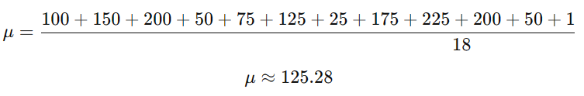
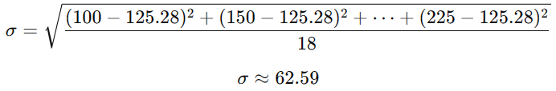
NORMALIZATION
A simple example with a small dataset of grayscale images representing letters in sign language. Each image is 3x3 pixels, and the pixel values range from 0 to 255.
[100, 150, 200],[50, 75, 125],[25, 175, 225]
CALCULATE MEAN:
STANDARD DEVIATION:
RESULT:
[100, 150, 200] --> [ (100 - 125.28) / 62.59, (150 - 125.28) / 62.59, (200 - 125.28) / 62.59 ]
[ 50, 75, 125] --> [ (50 - 125.28) / 62.59, (75 - 125.28) / 62.59, (125 - 125.28) / 62.59 ]
[ 25, 175, 225] --> [ (25 - 125.28) / 62.59, (175 - 125.28) / 62.59, (225 - 125.28) / 62.59 ]

Slide 24
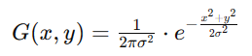
NOISE REDUCTION
Noise reduction refers to the process of minimizing or removing unwanted variations, disturbances, or artifacts from a signal or data. In the context of image processing and computer vision, noise reduction specifically focuses on mitigating noise present in digital images.
The Gaussian blur formula represents the operation of convolving an image with a Gaussian kernel to produce a smoothed version of the image.
FORMULA:

Slide 25
NOISE REDUCTION
Noise reduction often involves applying filtering techniques, such as Gaussian blur or median filtering, to smooth out pixel values and suppress high-frequency noise..
For sample the following noisy 3x3 image
Before noise reduction After noise reduction
[105, 200, 90] [105, 130, 105]
[55, 80, 130] [80, 105, 105]
[30, 180, 220] [80, 105, 130]

Slide 26
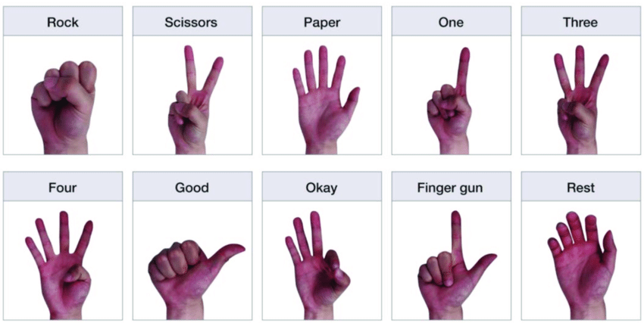
4.CLASSIFICATION
In this module, the pre-processed hand images or video frames are fed into the trained CNN model for classification.
The CNN model analyzes the spatial features and patterns present in the input data to identify and classify specific sign language gestures.
Classification results in the prediction of the corresponding sign language symbols or actions performed by the hand.

Slide 27
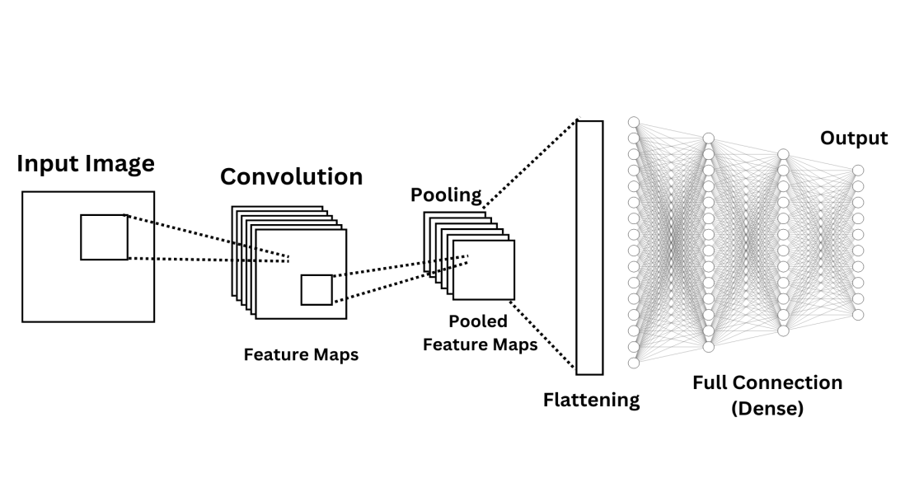
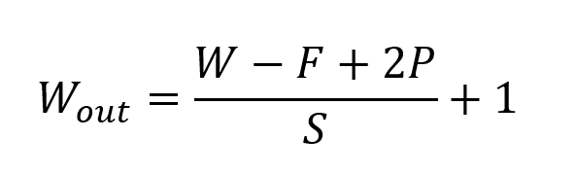
CONVOLUTIONAL NEURAL NETWORK (CNN)
A technique designed to automatically extract features from images, commonly used for tasks such as image classification and object detection.
The classification process in a CNN involves multiple mathematical operations within its layers, including convolutions, pooling, and fully connected layers. The output of the final fully connected layer is often passed through a softmax function to convert the raw scores into probability distributions over the class labels.

Slide 28

POOLING LAYER
A pooling layer, is a type of layer commonly used in Convolutional Neural Networks (CNNs) for reducing the spatial dimensions (width and height) of feature maps while retaining important information.

Slide 29
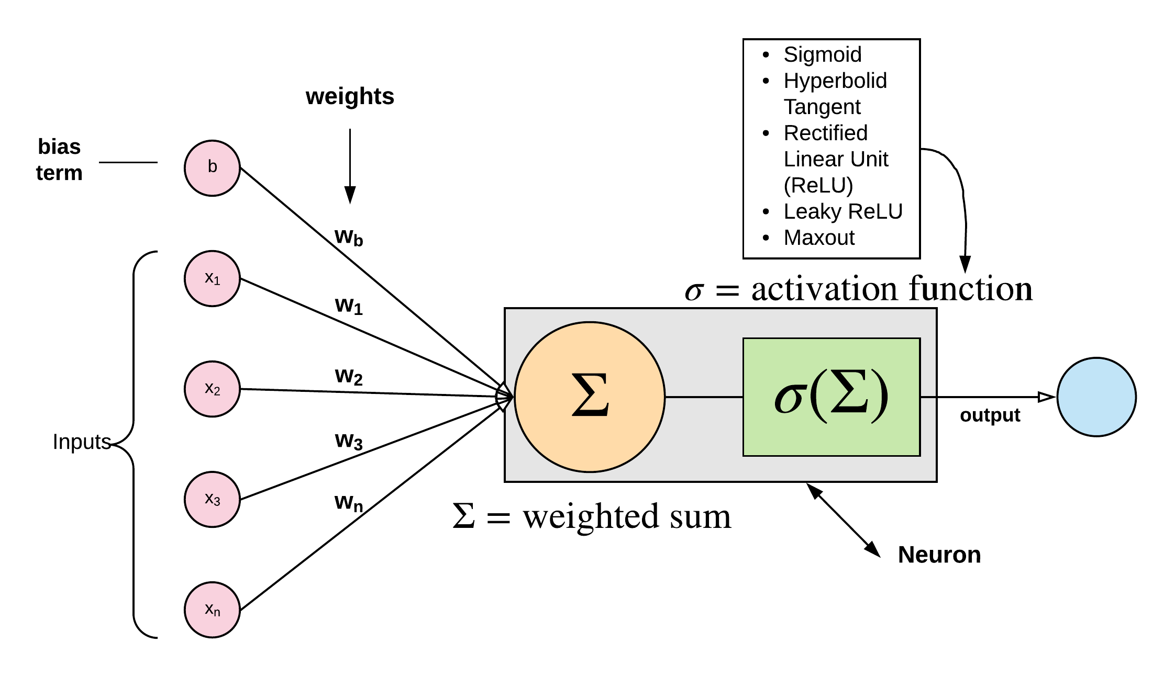
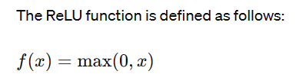
ACTIVATION FUNCTION
Activation layers, or activation functions, are applied element-wise to the output of each neuron in a neural network layer.
The activation function introduces non-linearity into the network, enabling it to learn complex mappings between input and output data.
Common activation functions include ReLU (Rectified Linear Unit), sigmoid, tanh (hyperbolic tangent), and softmax.

Slide 30
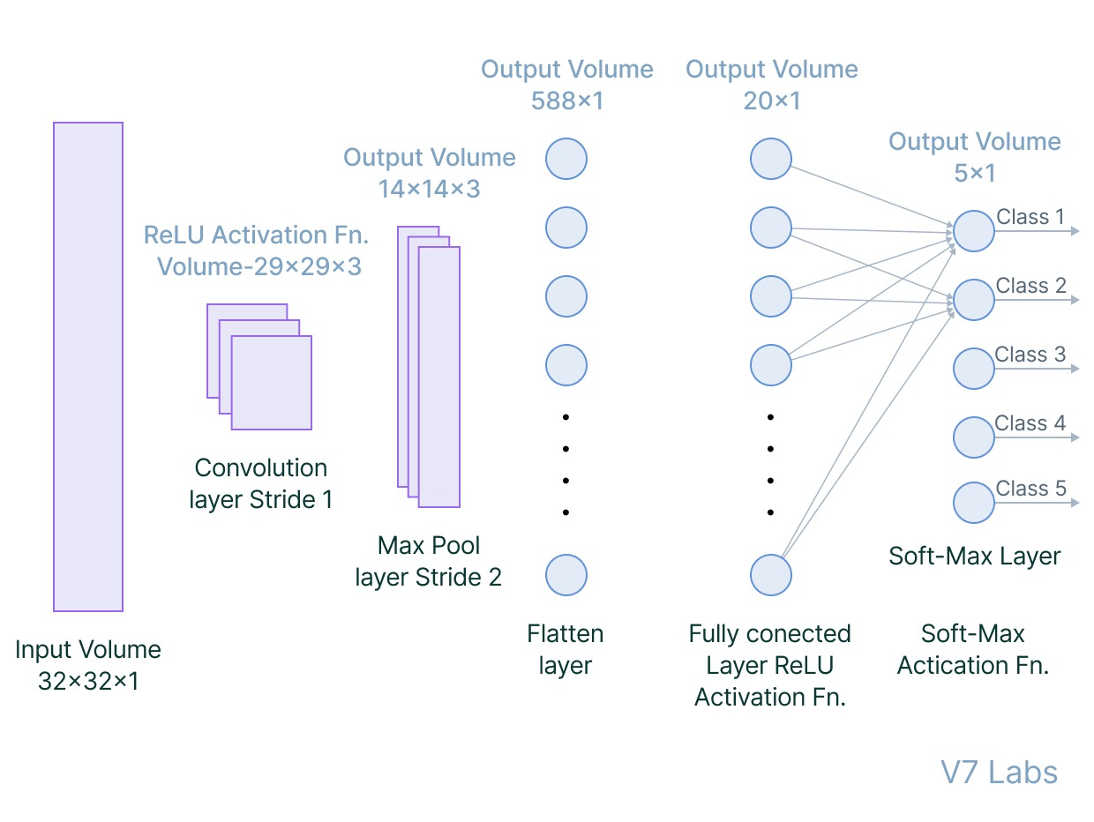
FULLY CONNECTED LAYER
A fully connected layer, also known as a dense layer, is a type of layer in a neural network where each neuron is connected to every neuron in the previous layer.

Slide 31
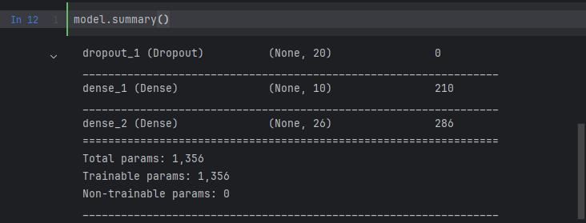
FULLY CONNECTED LAYER(DENSE)

Slide 32
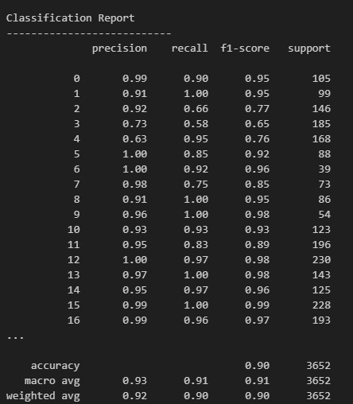
CLASSIFICATION

Slide 33
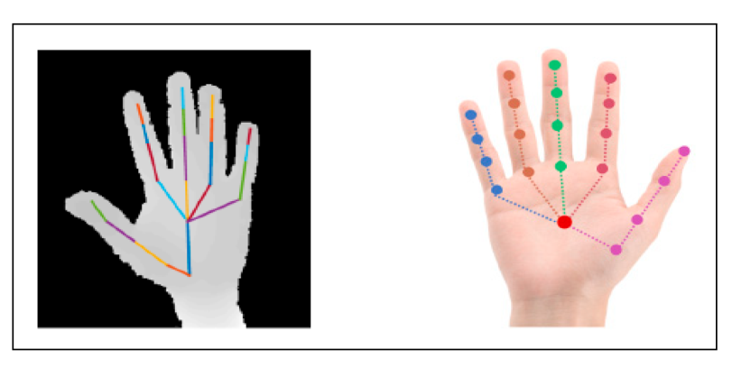
5.ACTION DETECTION
The final module focuses on detecting the action or meaning associated with the recognized sign language gesture.
It involves mapping the classified gestures to their corresponding meanings or actions based on a predefined dictionary or lookup table.
The detected actions or symbols are then translated into text, speech, or other forms of output to facilitate communication for individuals with hearing impairments.

Slide 34
CONFUSION MATRIX
By incorporating a confusion matrix into the evaluation process, we can gain a better understanding of the model's strengths and weaknesses and make informed decisions to enhance its performance.
Based on the analysis of the confusion matrix , adjustments and improvements can be made to the action detection system.

Slide 35
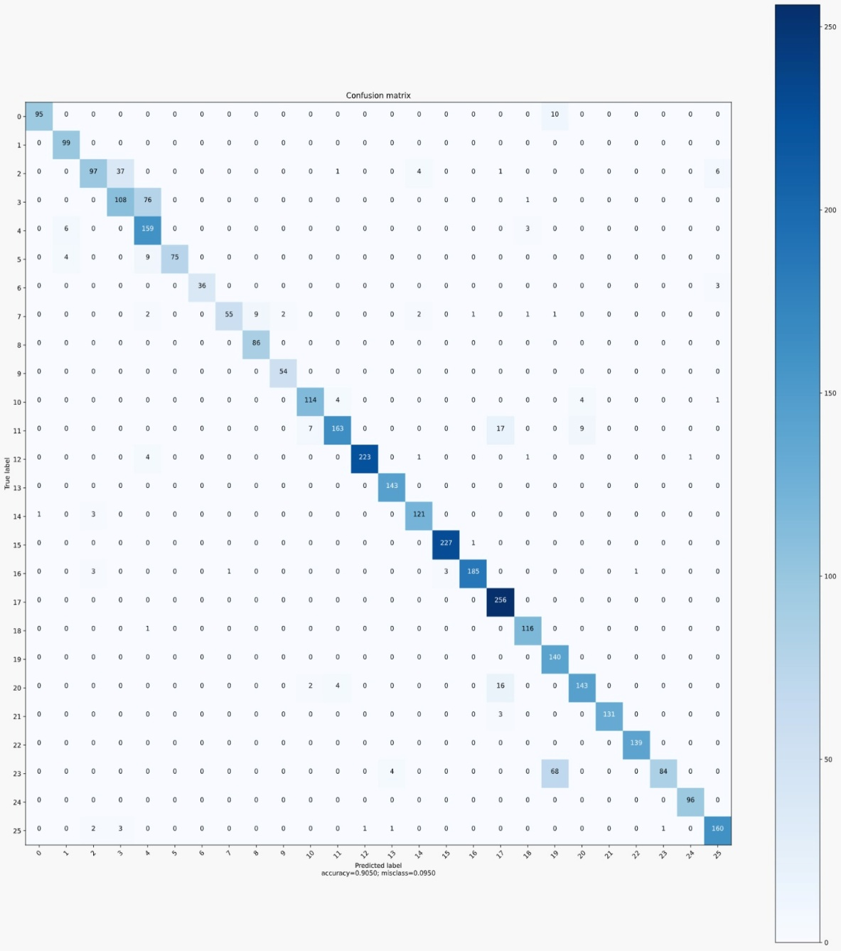
CONFUSION MATRIX

Slide 36
RESULT
CNN-based sign language detection achieved high accuracy in recognizing hand gestures, demonstrating the effectiveness of computer vision techniques.
However, challenges such as occlusions and variations in hand poses still posed difficulties, suggesting the need for further refinement in algorithm robustness.

Slide 37
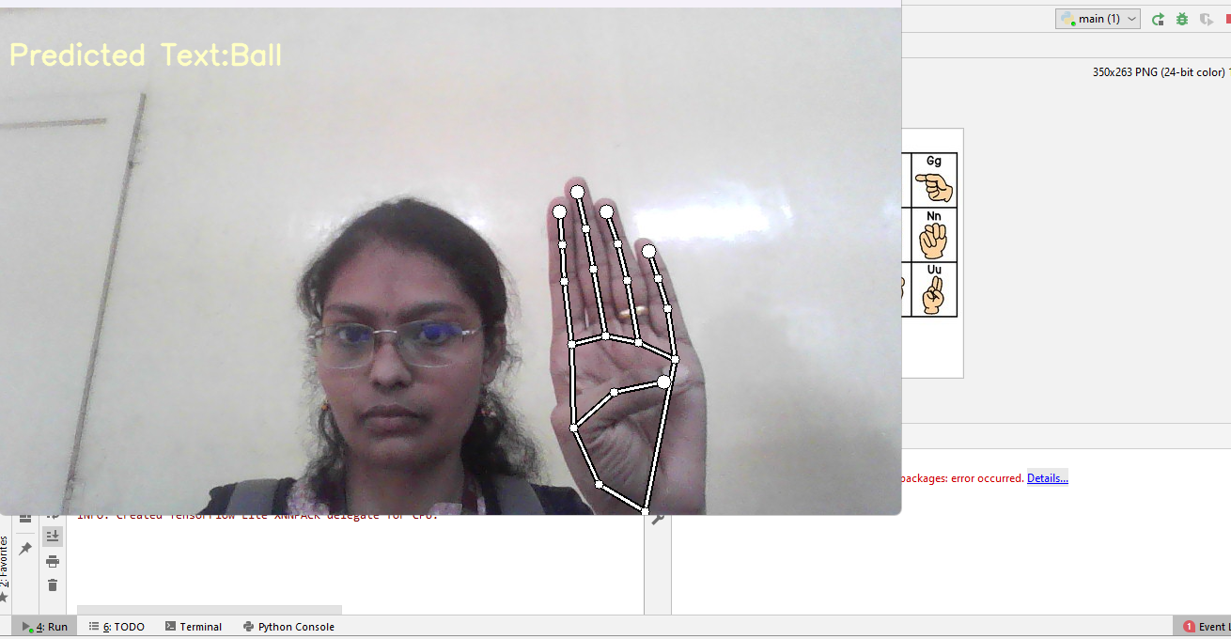
RESULT

Slide 38
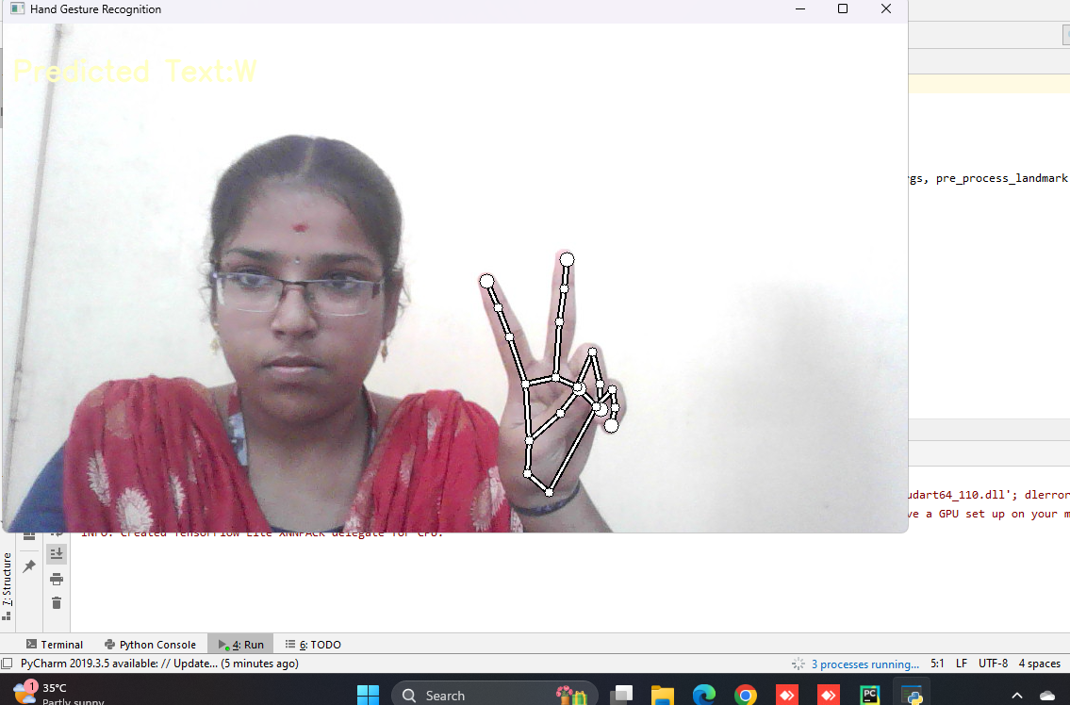
RESULT

Slide 39
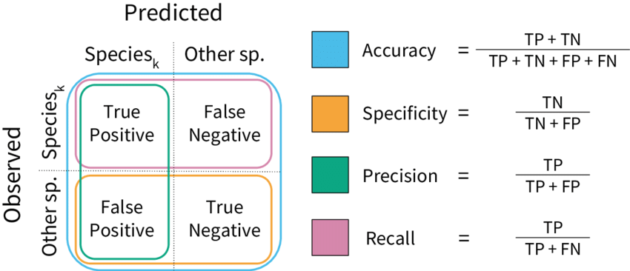
PERFORMANCE METRICS USED

Slide 40
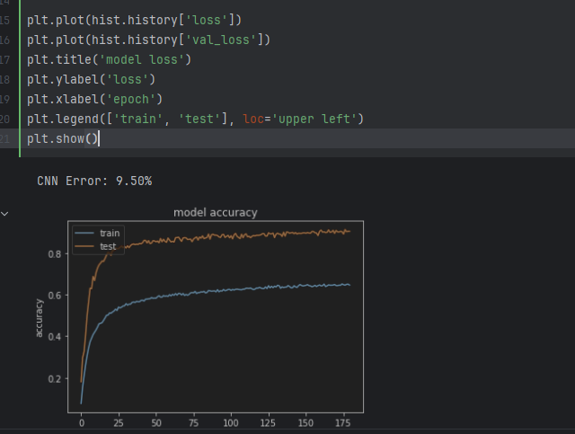
PERFORMANCE METRICS USED

Slide 41
COMPARATIVE ANALYSIS OF ALGORITHMS
Algorithm | Accuracy (%) | Explanation
SVM | 85.2 | SVM achieves a decent accuracy in object detection tasks but may struggle with complex features.
ANN | 88.7 | ANN performs slightly better than SVM due to its ability to learn complex patterns in data.
KNN | 82.5 | KNN demonstrates moderate accuracy but may be sensitive to noise and require careful parameter tuning.
ResNet | 91.4 | ResNet outperforms traditional machine learning algorithms, leveraging deep learning techniques to capture intricate objects features.
CNN | 97.8 | CNN performs well in Sign detection tasks, but ResNet's architecture might be more efficient in extracting features from images, leading to slightly higher accuracy.
“CNN SHOWS THE HIGHEST ACCURACY”

Slide 42
CONCLUSION
In conclusion, hand gesture-based sign language detection in computer vision using CNN algorithm demonstrates promising potential for accurately interpreting sign language gestures, paving the way for enhanced communication accessibility for individuals with hearing impairments.
With further advancements in CNN technology and dataset refinement, these systems hold the key to more inclusive and effective communication tools for the deaf and hard of hearing community.

Slide 43
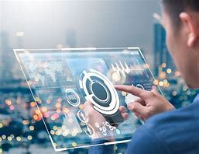
FUTURE ENHANCEMENT
Future enhancements for hand gesture-based sign language detection in computer vision may involve implementing more advanced deep learning architectures and incorporating multimodal sensor data fusion to improve accuracy and robustness in recognizing complex hand movements and gestures.

Slide 44
REFERENCES
www.semanticscholar.org
Rathod, m.; Dalvi, c.; Kaur, k.; Patil, s.; Gite, s.; Kamat, p.; Kotecha, k.; Abraham, a.; Gabralla, l.A. Kids’ emotion recognition using various deep-learning models with explainable ai. Sensors 2022, 22, 8066. [Crossref] [pubmed]
Azhar, R.; Tuwohingide, D.; Kamudi, D.; Suciati, N. Batik image classification using SIFT feature extraction, bag of features and support vector machine. Procedia comput. Sci. 2015, 72, 24–30. [Crossref]
Sharma, S.; Gupta, R.; Kumar, A. Trbaggboost: an ensemble-based transfer learning method applied to indian sign language recognition. J. Ambient. Intell. Humaniz. Comput. 2020, 13, 3527–3537. [Crossref]
home | springerlink

Slide 45
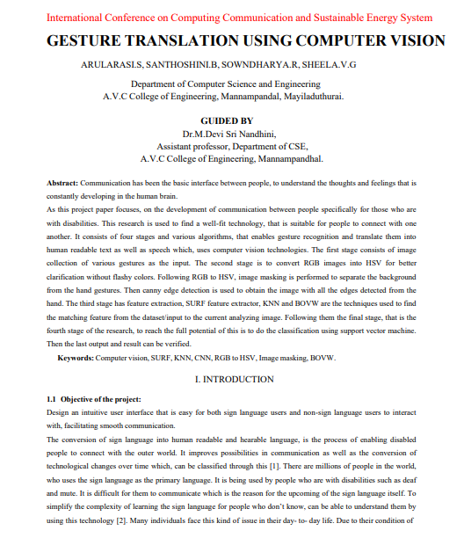
PUBLICATION

Slide 46
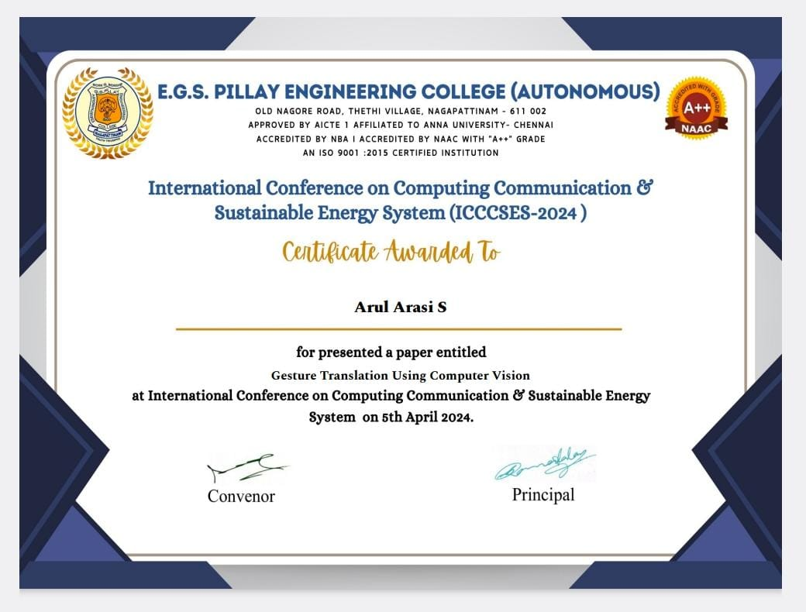
CERTIFICATE(1)

Slide 47
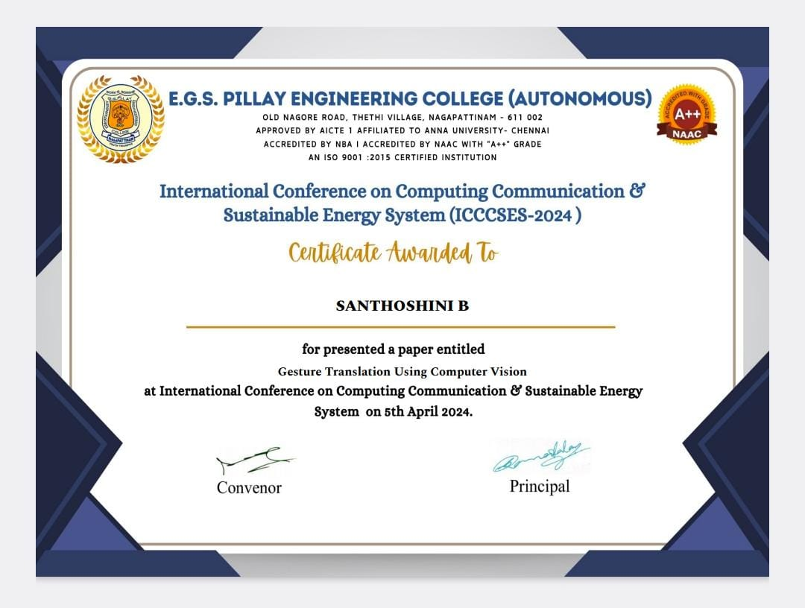
CERTIFICATE(2)

Slide 48
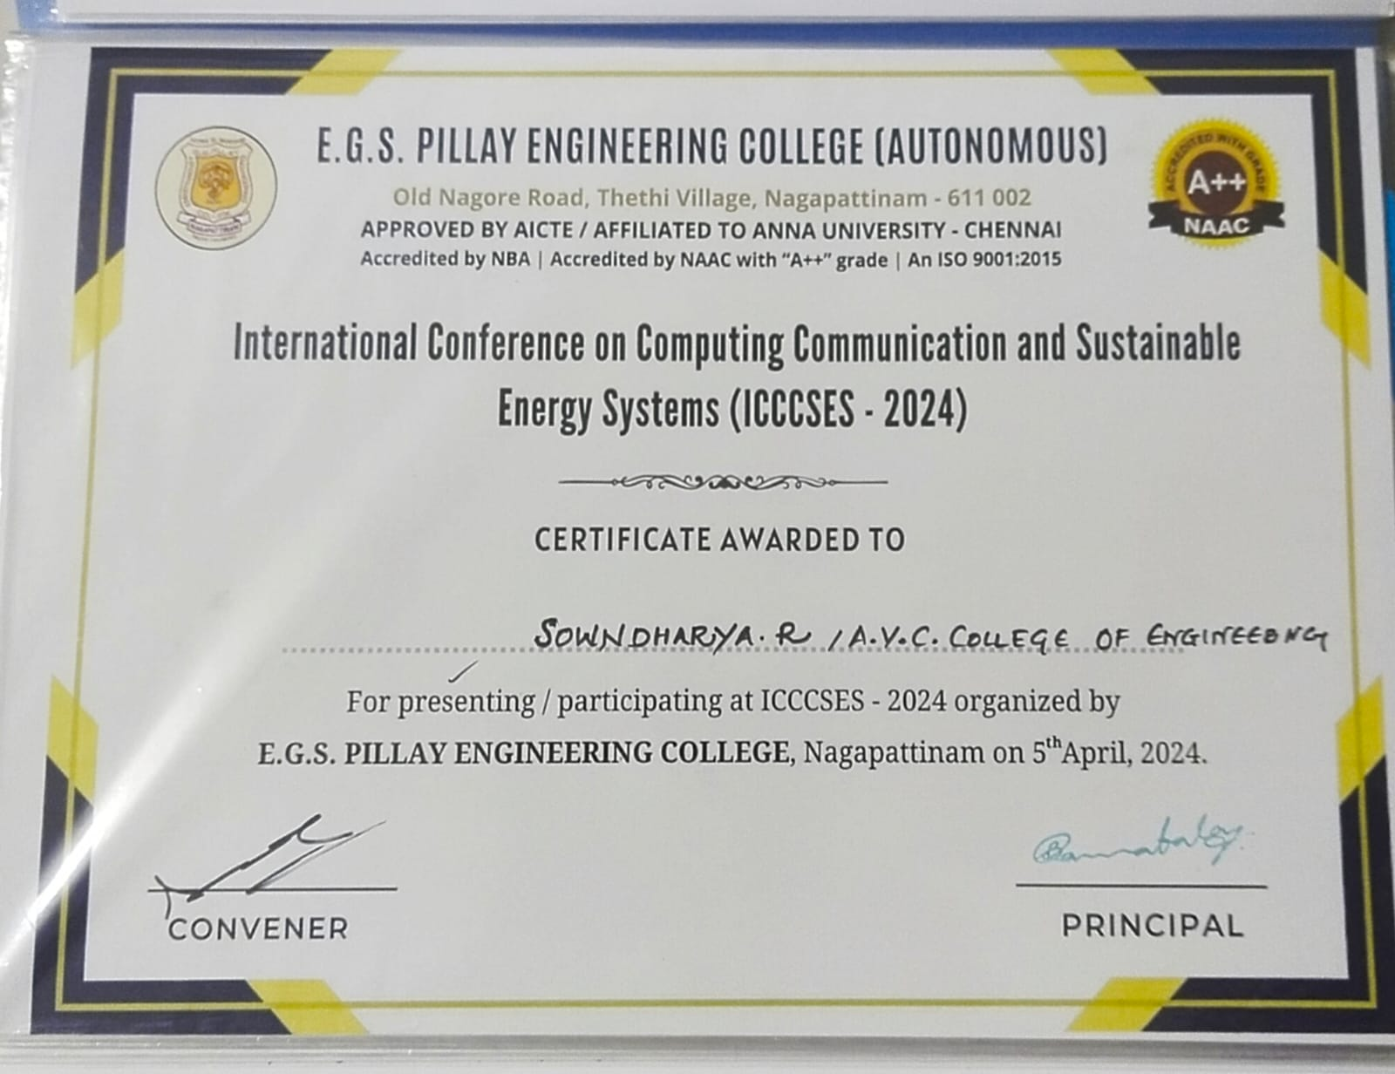
CERTIFICATE(3)

Slide 49
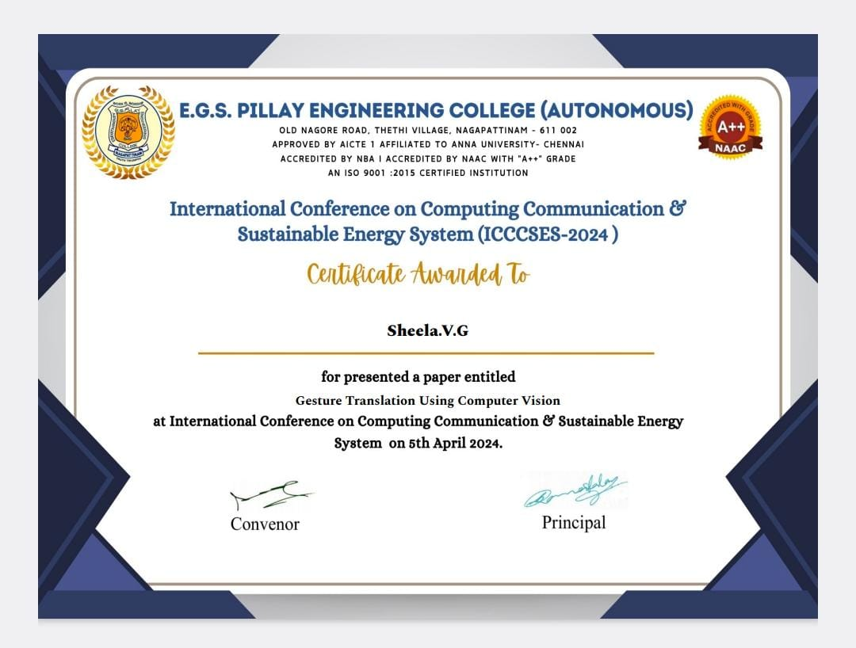
CERTIFICATE(4)

Slide 50


